Slide 1

C Operators
Khwima Mkamanga

Slide 2
What is an Operator
  An operator is a symbol that tells the computer to perform certain mathematical or logical manipulations.
  These operators are used in programs to manipulate data and variables.

Slide 3
Types of Operators
  C divides the operators into the following groups:
    Arithmetic operators
    Assignment operators
    Comparison operators
    Logical operators
    Sizeof Operator

Slide 4
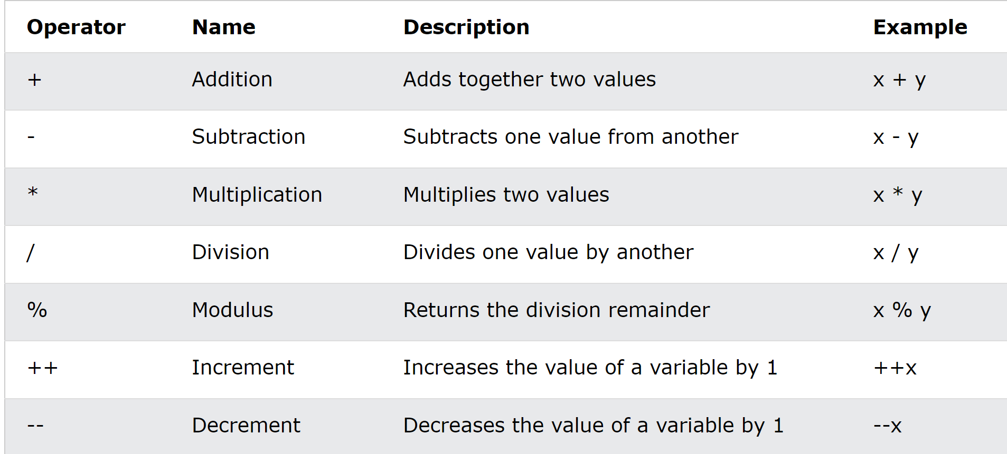
Arithmetic operators:
  Arithmetic operators are used to perform numerical calculations among the values.
  An arithmetic operator performs mathematical operations such as addition, subtraction, multiplication, division etc on numerical values (constants and variables).

Slide 5
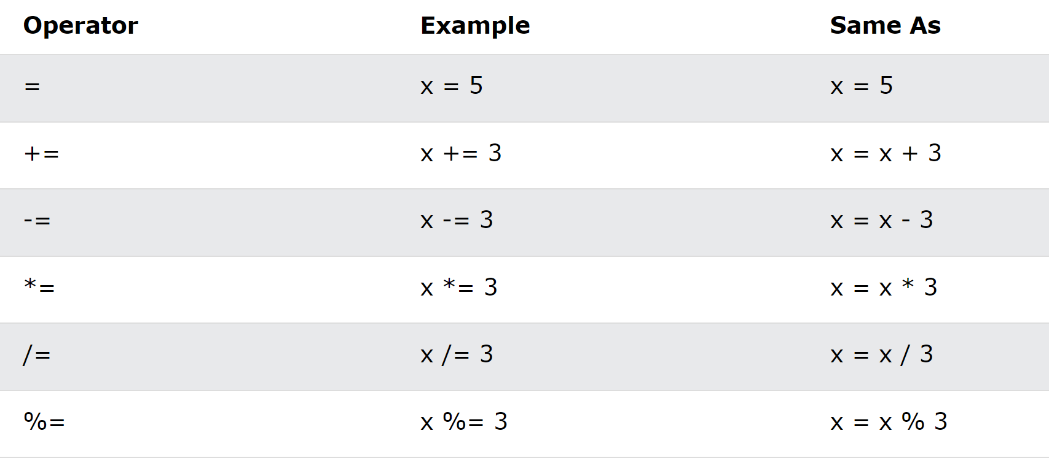
Assignment Operators
  Assignment operators are used to assign values to variables.

Slide 6
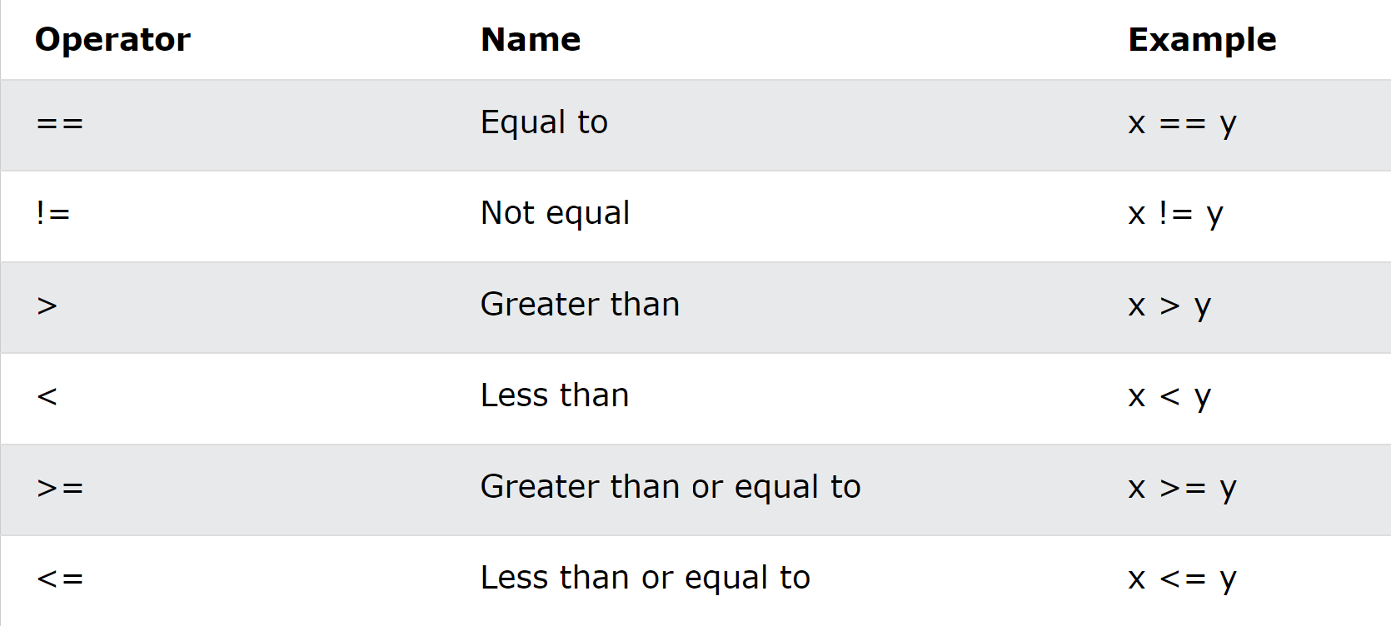
Comparison Operators
Comparison operators are used to compare two values (or variables). This is important in programming, because it helps us to find answers and make decisions.
The return value of a comparison is either 1 or 0, which means true (1) or false (0). These values are known as Boolean values.

Slide 7
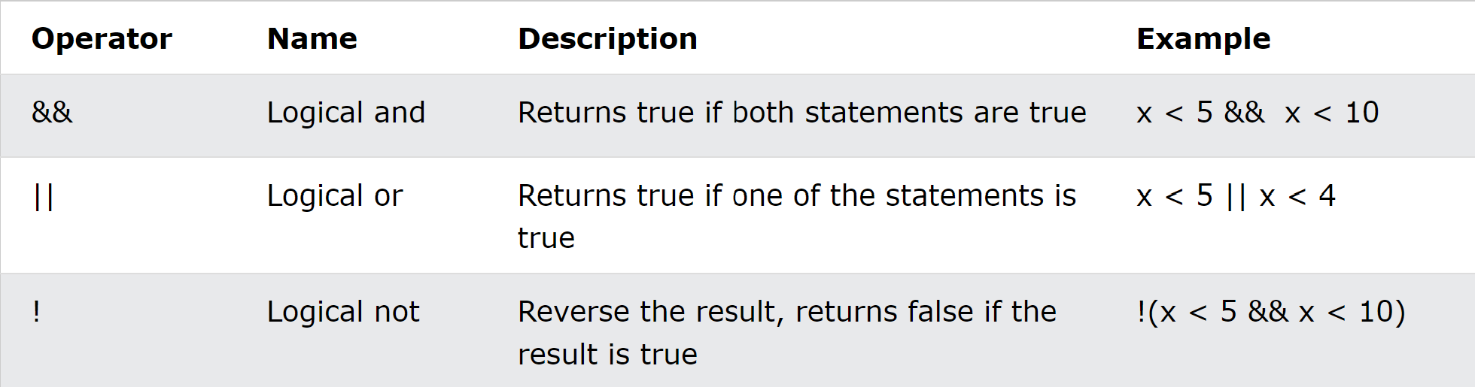
  An expression containing logical operator returns either 0 or 1 depending upon whether expression results true or false.
  Logical operators are commonly used in decision making in C programming.

Slide 8
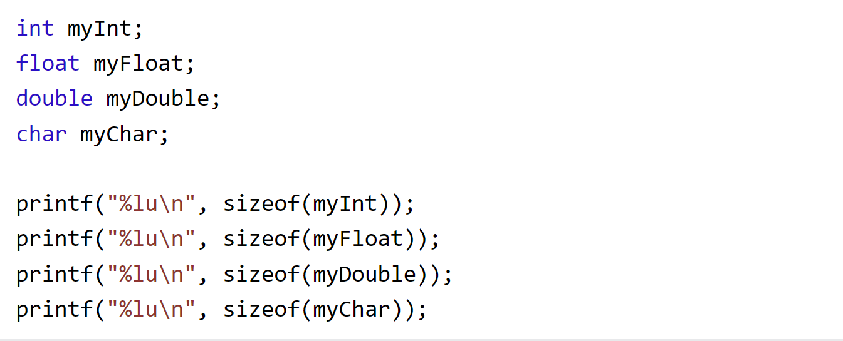
Sizeof Operator:
  The sizeof is a unary operator that returns the size of data (constants, variables, array, structure, etc).
  Example
Sizeof operators use %lu format specifier because the compiler expects the sizeof operator to return a long unsigned int (%lu), instead of int (%d).

Slide 9
Exercises
  You are creating a program for a shipping company. Write a C program that prompts the user to enter the weight of a package and the distance to be shipped. Calculate the shipping cost based on a fixed rate per kilogram and the distance traveled. Display the shipping cost to the user.
  You are building a ticket reservation system for a cinema. Write a C program that asks the user to input the number of tickets required and the ticket price. Calculate the total cost of the tickets, including a service fee of MK2000 per ticket, and display the final amount to the user.

